Slide 1
Anaphora Resolution in Biomedical Abstracts
Syed Toufeeq Ahmed
CIPS, ASU

Slide 2
Anaphor, Antecedent, Referent
Anaphora is the device of making in discourse .. reference to some entity (or entities). This reference is called Anaphor, and the entity to which it refers is its referent or antecedent. A reference and its referent are said to be co-referential.
    - G. Hirst (1981)

Slide 3
Anaphora Resolution
The “pointing back” (reference) is called an anaphor and the entity to which it refers is its antecedent [1].
Example:
“The Empress hasn’t arrived yet but she should be here any minute.”

Slide 4
Various types of anaphora
Pronominal anaphora – most widespread type of anaphora, realized by anaphoric pronouns.
Example:
“Human growth hormone (hGH) binds to its receptor (hGHr) in a three-body interaction : one molecule of it and two identical monomers of the receptor form a trimer[2].”
In BioMedical Abstracts, pronominal anaphors are mostly either third person pronouns or reflexive pronouns.

Slide 5
Various types of anaphora
Sortal anaphora:
“We quantitatively analyzed the relationship between the structure and inhibiting activity of these substances toward acetylcholinesterase and butyryl cholinesterase. Hydrophobic interactions were found to be important for the inhibition of both enzymes but are more pronounced in the case
of butyryl cholinesterase [1].”
In Medline abstracts, 60 % are sortal anaphors [2].

Slide 6
Various types of anaphora
Event anaphora:
The event anaphora refers to the fact expressed by the whole sentence or to the event variable in the underlying semantic representation of their antecedent.
Example:
  “Peter first went to L.A, then to Chicago and stopped for one night at Boston before finally arriving at Phoenix. This trip went on smoothly with no hiccups.”

Slide 7
Anaphora Resolution in Biomedical Abstracts – [Jos´e Casta˜no, Jason Zhang, James Pustejovsky ]
Preprocessing of Medline text :
  Noun Phrases (NP) are identified (Shallow parsing).
  Annotation with
  a) Syntactic information (POS tagger, a variant of Brill’s)
  b) Semantic information (UMLS type system)
Syntactic Chunk Object (SCO): Each NP is represented by SCO which contains Syntactic information (i.e., number, person ..), UMLS type and string information.

Slide 8
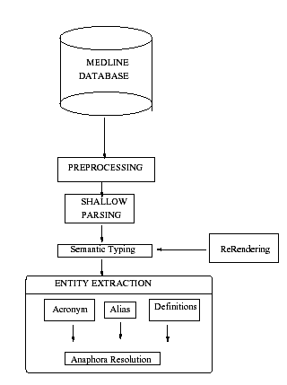
Anaphora Resolution in Biomedical Abstracts [2]

Slide 9
Algorithm
Represent each sentence as a frame environment, which contains all SCOs and anaphors.
Each anaphor is resolved by traversing the sentence environment (the most recent) , back to the beginning of the abstract.
Select SCO that has highest cumulative salience score.

Slide 10
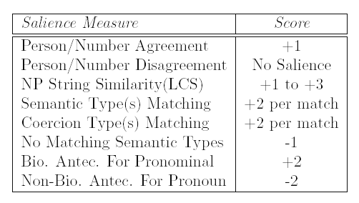
Salience Measure
Cumulative weight used to denote the compatibility of a candidate
antecedent with the anaphor.
In case of tie, candidate proximal to the anaphor is preferred (Context Recency Effect).

Slide 11
Candidate Anaphor Identification
Two stages of selective filtering:
  1. Based on Syntactic Type:
    All third person personal, possessive and reflexive pronouns are candidate anaphors.
    The definite NP are considered as sortal anaphors.
  2. Based on Semantic Type:
    Candidate anaphors that correspond to the relevant bio-types (UMLS types ) are selected.
    The number of antecedents required by each anaphor is also identified (e.g. ‘both enzymes’, ‘these proteins’ etc..)

Slide 12
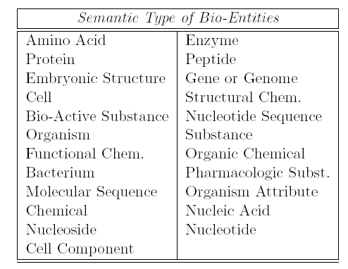
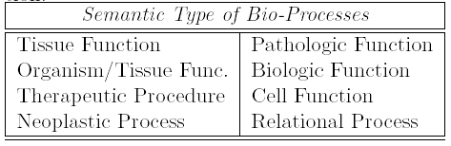

Slide 13
Pronominal Coercion
Using Semantic type information
Using frequent types associated with Agent and patient role of the verbs, whenever a pronominal was found either as agent or patient, then it is coerced to bear that type.
For predicate ‘inhibit’ coerced types are:
Agent: [‘Amino Acid, Peptide or Protein’, ‘Biologically Active Substance’, ‘Chemical Viewed Functionally’,….]
Patient: [‘Amino Acid, Peptide or Protein’, ‘Organic Chemical’, ‘Pharmacologic Substance’,…..]

Slide 14
Multiple Antecendents
If an anphor requires multiple antecendents (e.g. “both enzymes”), sentence environment of first antecedent is searched.
Selecting the subsequent antecedent is based on combined salience measure of candidate NP and first antecedent.

Slide 15
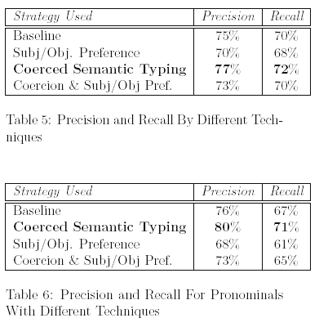
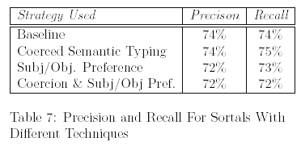
Results

Slide 16
References
[1] R. Mitkov. 1999. Anaphora resolution: The state of the art.
[2] Jos´e Casta˜no, Jason Zhang, James Pustejovsky:
Anaphora Resolution in Biomedical Literature
[3] R. Mitkov. 1998. Robust pronoun resolution with limited knowledge.

